Slide 1

Eat Well,
Feel Well
Grades 7–9
Together For Health

Slide 2
2/3
of Canadian teens do not eat enough fruits and vegetables daily (Statistics Canada)
Only 1 in 4 teens meets the Canada Food Guide recommendations.
Together For Health

Slide 3

⚡
Nutrition & Your Performance
Brain runs on glucose — complex carbs provide steady fuel
Omega-3 fatty acids (fish, flaxseed) improve memory and focus
Iron deficiency is #1 cause of fatigue in teen girls
Protein is essential for muscle growth and immune function
Hydration affects concentration — even 2% dehydration reduces performance
Together For Health

Slide 4
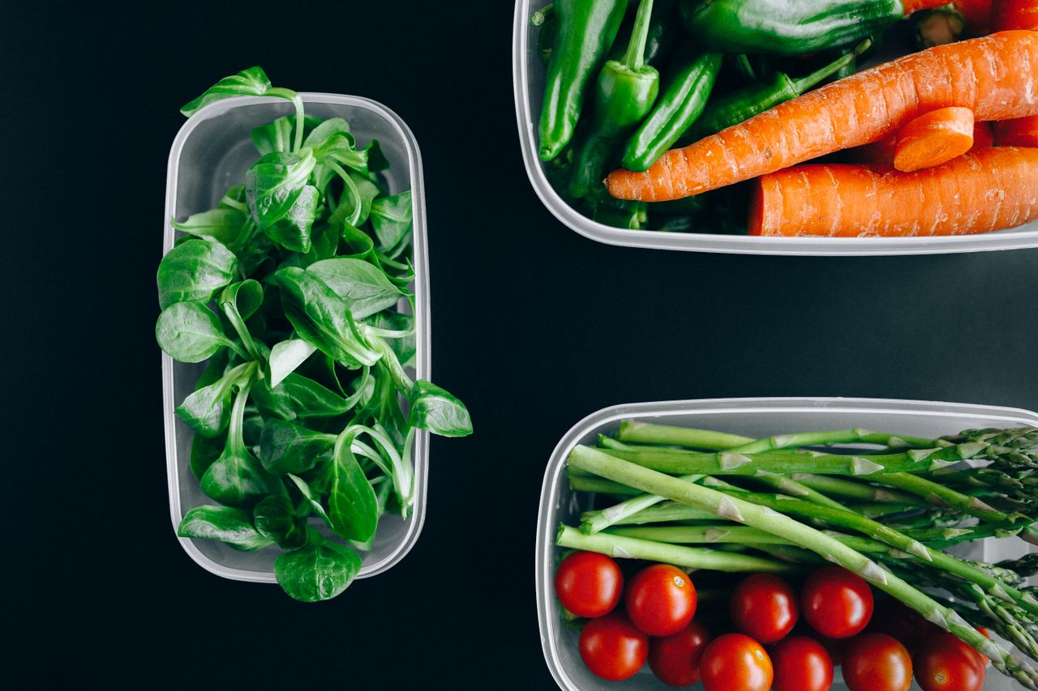
🚫
What Ultra-Processed Food Does
Designed to be addictive — triggers same brain pathways as drugs
High in sodium, sugar, and trans fats — all risk factors for disease
Low in actual nutrients despite high calorie count
Linked to depression and anxiety (gut-brain axis research)
80% of teen diets in Canada contain too much ultra-processed food
Together For Health

Slide 5

🥘
The Gut-Brain Connection
90% of serotonin is produced in your GUT, not your brain
1
The gut microbiome communicates directly with your brain
2
High-fiber diets support healthy gut bacteria
3
Fermented foods (yogurt, kimchi) improve gut diversity
4
Poor gut health linked to anxiety, depression, and brain fog
5
Together For Health

Slide 6
🍔
The Ultra-Processed Problem
Teens who eat mostly ultra-processed foods are 20% more likely to develop depression.
The evidence connecting diet to mental health is now overwhelming. What you eat is mental health care.
Together For Health

Slide 7
KEY TAKEAWAYS
Food is medicine — literally
✓
The gut-brain connection means eating well is self-care
✓
Small swaps (water over soda, fruit over chips) add up massively
✓
Resources
Canada Food Guide: food-guide.canada.ca
PCRM Nutrition Resources: pcrm.org
dietitians.ca — find a local dietitian
Together For Health

